Slide 1
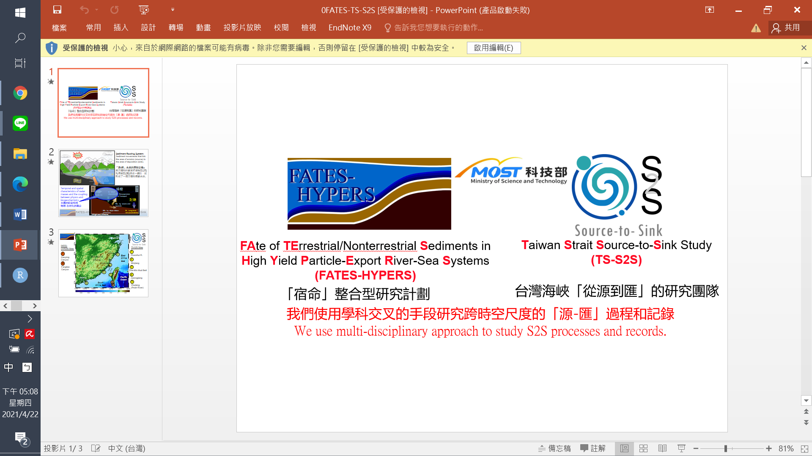

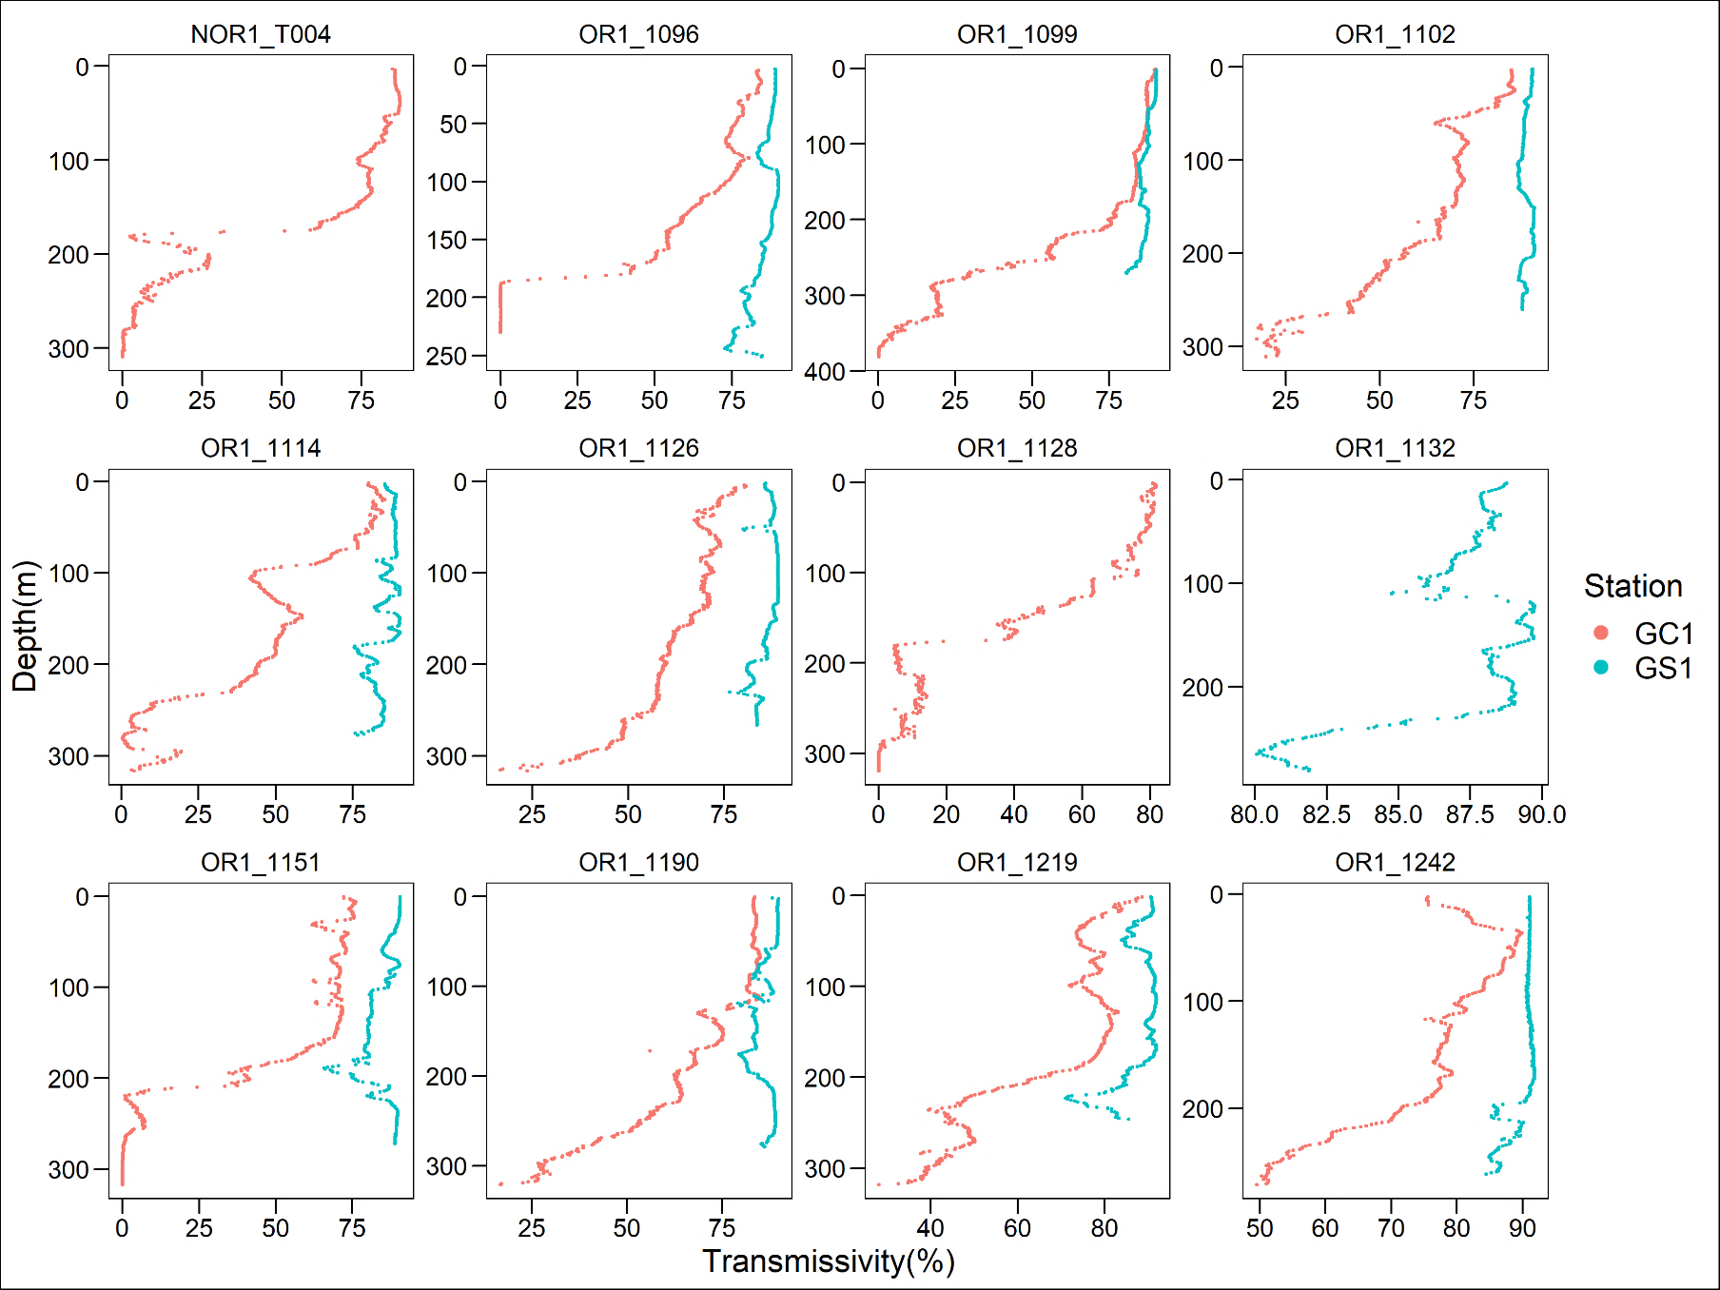
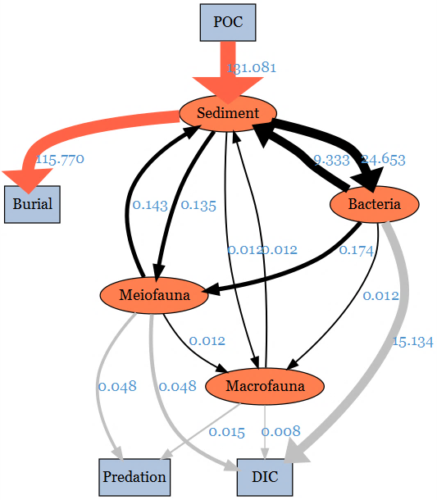
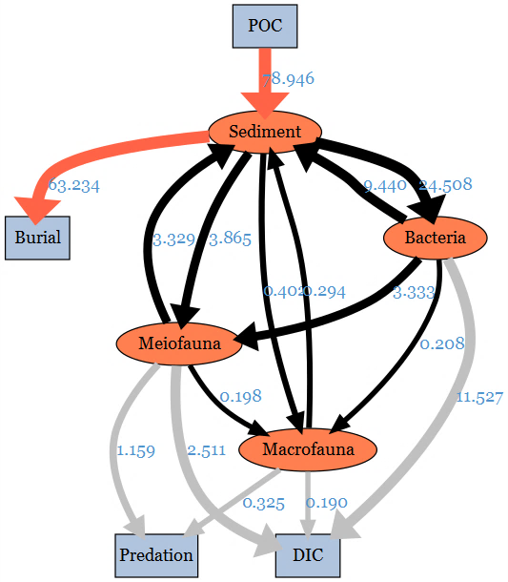
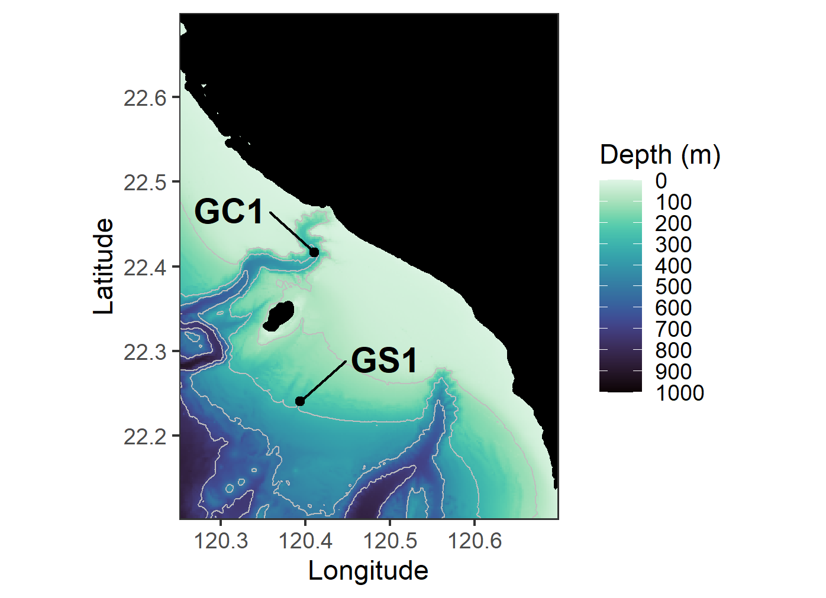
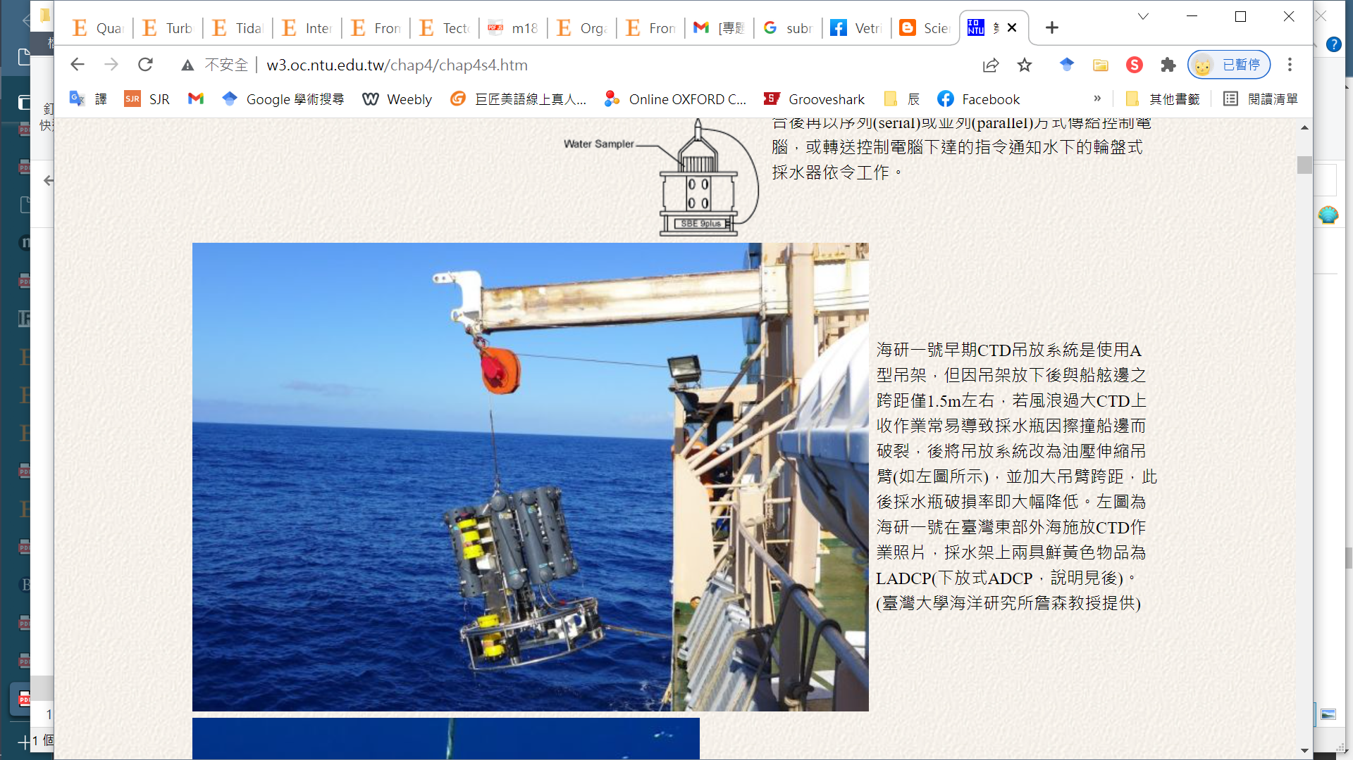
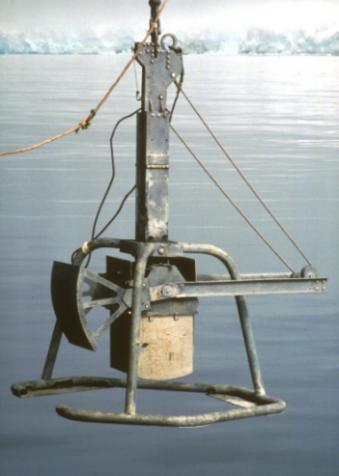
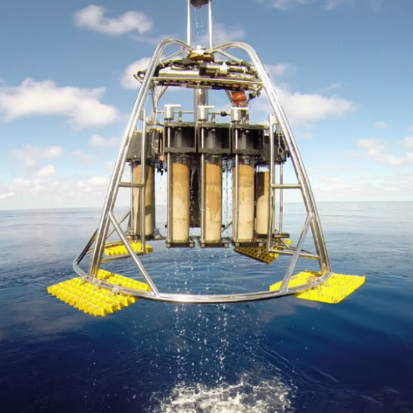
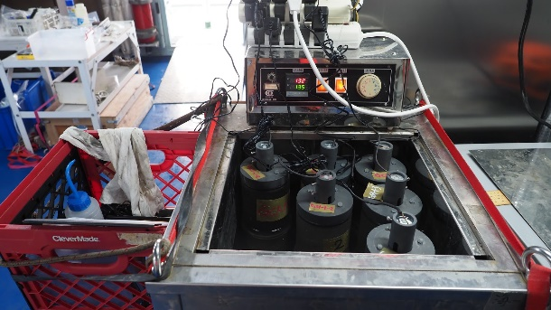
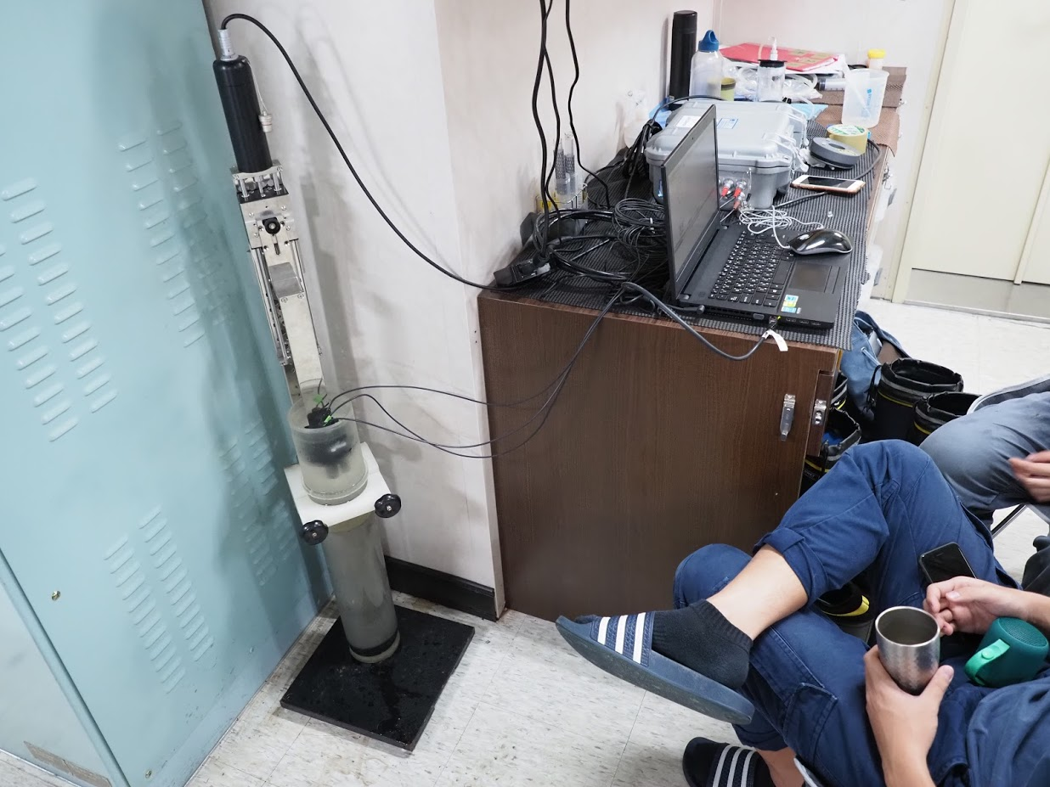
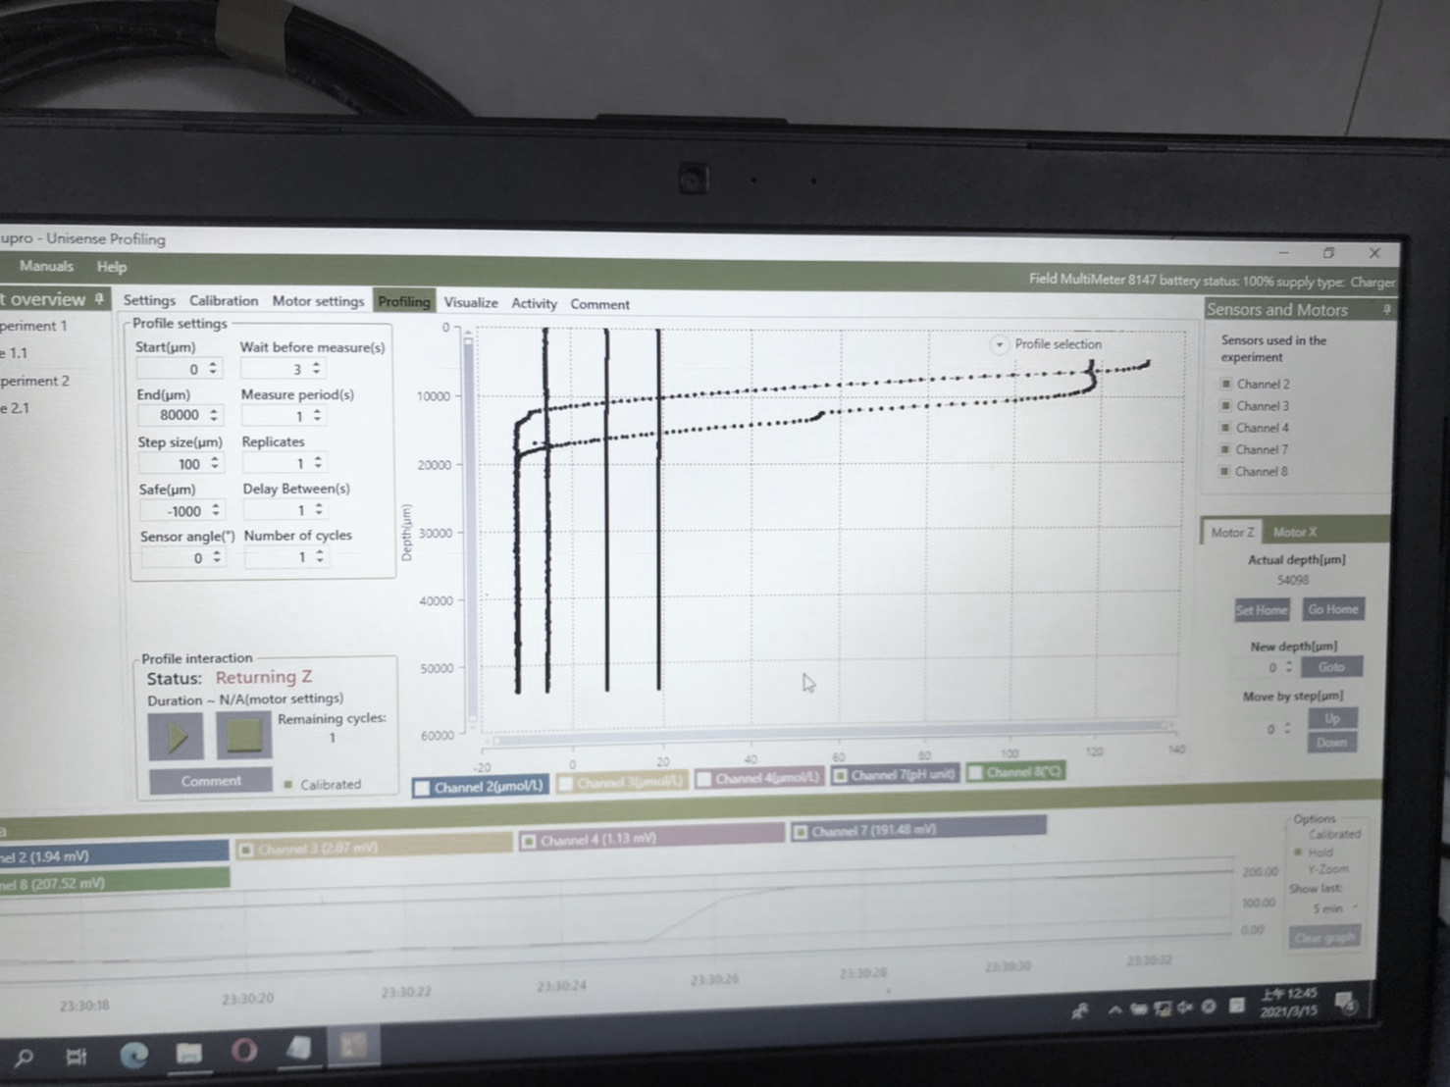
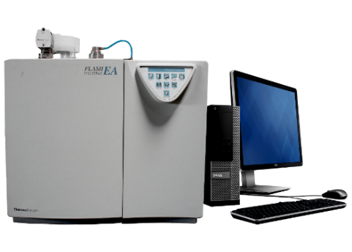

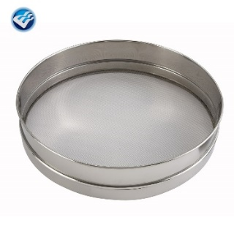
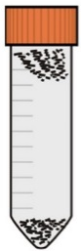
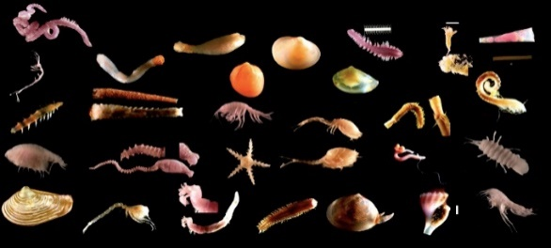
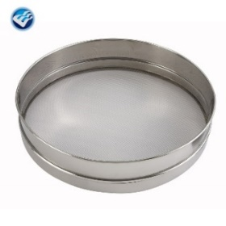

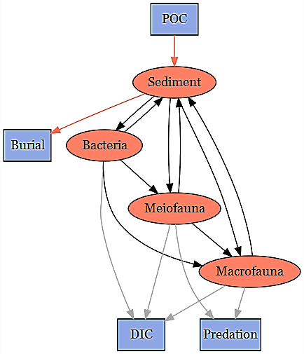

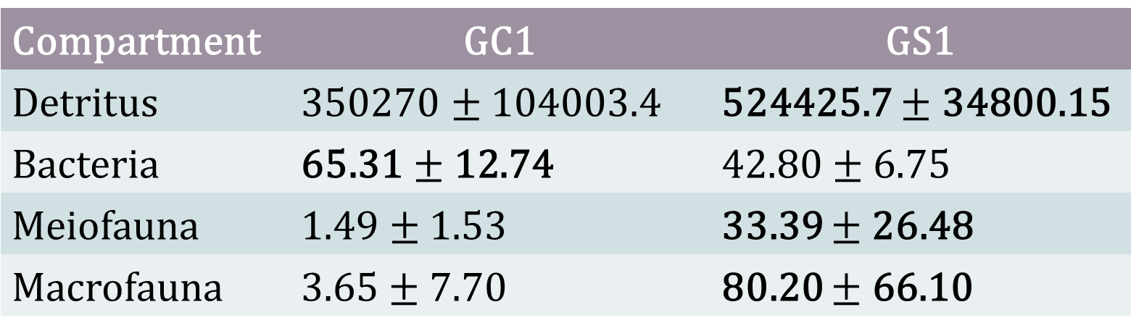
高屏峽谷之底棲生物食物網中的碳循環
Carbon Cycling in Benthic Food Web of the Gaoping Submarine Canyon
Chueh-Chen Tung¹, Chih-Lin Wei¹
¹Institute of Oceanography, National Taiwan University
Introduction
Results
The Gaoping Submarine Canyon (GPSC) off Southwest Taiwan has been extensively studied for its geology and biological community structure. However, the carbon cycle across the sediment-water interface and environmental control on ecosystem functioning remained unclear. This study attempts to contribute knowledge gap in benthic foodweb by quantifying the carbon cycling in this SMR-fed submarine canyon ecosystem.
Environment data
Station | Average bottom water temp (°C) | Tlim
GC1 | 13.54 | 1.05
GS1 | 13.90 | 1.09
Table 1. Average bottom water temperature and the calculated $\text{Tlim}$ of GC1 and GS1.
Aims of this study
Figure 3. Light transmission profile for each cruise of the two sites. Note that GC1 has a very low light transmission below 200 meter depth in almost all the sampling cruises.
Estimate the biotic and abiotic carbon stocks in the upper GPSC (abbreviated as GC1) and adjacent slope (abbreviated as GS1)
Examine whether the seasonal difference existed in these stock estimates.
Combine biological and geochemical data collected at GC1 and GS1 from 2014 to 2020 and literature data to compare the carbon fluxes between the two sites.
Construct linear inverse models (LIM) to compare carbon flows in simplified food webs.
Use selected network indices to examine the ecosystem function and characteristics of the GC1 and GS1 foodwebs.
Carbon stocks
N.S.D in Seasonality in all stocks
Compartment | GC1 | GS1
Detritus | 350270 $±$ 104003.4 | 524425.7 $±$ 34800.15
Bacteria | 65.31$±$12.74 | 42.80$±$6.75
Meiofauna | 1.49 $±$ 1.53 | 33.39 $±$26.48
Macrofauna | 3.65$±$7.70 | 80.20 $± \text{66.}\text{10}$
Table 2. Standing stocks (in mg C/ m²) as mean± standard deviation of the food web compartments for GC1 and GS1.
Model results
GC1
GS1
Figure 4. The conceptual model plotted with LIM results of GC1 and GS1 processed with the MCMC algorithm. The flows were drawn to scale.
Materials and Methods
Sampling sites
Sampling gears
CTD
Box corer
Multicorer
GC1
POC demand: 131.08 mg C/ m²/ d
Burial: 88% of the POC input
Strong interactions between bacteria and the environment
Remaining flows less than 1 mg C/ m²/ d
GS1
POC demand: 131.08 mg C/ m²/ d
Burial: 80% of the POC input
Metazoan contribution increased
Ship-board incubation
Turnover rate
Sediment oxygen profiling
Station | OC_{Total}/TOU (yr) | OC_{Bac}/DOU | OC_{(Meio+Macro)}/BMU | Method
GC1 | 13.22 | 3.2970 | 0.0824 | Direct measurement
 | 62.94 | 4.3155 | 44.6422 | Model results
GS1 | 19.80 | 3.6654 | 1.8318 | Direct measurement
 | 101.02 | 3.7129 | 42.0642 | Model results
Sampling cruises (2014/11-2020/11)
Figure 1. The map of sampling stations of the upper Gaoping Submarine Canyon (GC1) and Gaoping Slope (GS1).
SP (2-4)
OR1_1099, OR1_1102, OR1_1128, OR1_1132, OR1_1190, OR1_1219
GC1: 120.41°E, 22.41°N
GS1: 120.40°E, 22.23°N
SU (8)
OR1_1026
AU (10-11)
OR1_1096, OR1_1126, OR1_1151, OR1_1242, NOR1_T004
Table 3. Stock turnover calculated with the two different estimations of oxygen utilization rates.
Carbon Stocks
Network indices
Table 4. Comparison of network indices calculated for GC1 and GS1.The numbers indicate the fraction of network values that are higher in GC1.
Detritus
Bacteria
Network indices | Fraction | Significance
Total system throughput (T..) | 0.9987 | *** (GC1>GS1)
Total system throughflow (TST) | 0.9623 | *** (GC1>GS1)
Finn cycling index (FCI) | 0.1034 | Marginally GC1< GS1
0-10 cm
TOC
1 cm
Cell counting
Sediment
Elemental analyzer
Sediment
2-mL plastic syringe
Conclusion
Meiofauna: 1 subcore from each deployment
This study is the first to use the food web model to understand carbon cycling in the GPSC and on the adjacent slope. Moreover, it is the first study that applied the LIM technique in Taiwan. The standing stocks of each compartment were significantly different between the two habitats. The relatively lower biodiversity and faunal carbon stocks show that the canyon is a fragile ecosystem under severe physical perturbation. The model results revealed that the bacteria-related process dominated the canyon head of the GPSC. By contrast, the higher contribution of fauna in carbon processing on the adjacent slope presents a relatively mature ecosystem. In addition, our models revealed a higher carbon burial rate in GC1, indicating that the GPSC not only transports sediment to the deep SCS but functions as a carbon sink, contributing to carbon sequestration. Owing to the ongoing climate change, the geohazards in the submarine canyons might become more frequent due to new weather systems with a higher intensity of flooding in SMRs. By better understanding carbon cycling in submarine canyons like GPSC, we may be able to predict the impact of climate change or human influence on deep-sea ecosystems.
5 cm
Sediment
50-mL plastic syringe x 3
40 µm sieve
Ludox flotation
Sorted and identified
Macrofauna: 3 subcores for each station
All samples were adequate converted to mg C/m²
10 cm
Sediment
300 µm sieve
Sorted and identified
LIM modelling
Decide structure
Set carbon stocks
Set Constraints
Sedimentation rate
Sediment burial efficiency
Growth efficiency
Maintenance respiration
Production to Biomass ratio
Calculate by MCMC algorithm
Site
Internal
Ref
Biotic input
Abiotic output
Figure 2. The conceptual model of the food web structure formed the basis of our linear inverse model (LIM).

